Slide 1
Faculty Senate Meeting
November 10, 2022

Slide 2
Meeting procedure
Only Senators may debate motions
Only Senators can vote
If you are not a Senator, or a proxy, you cannot vote or debate
Do not speak over someone, or out of order
Raise your hand to speak
The President may call on you and then you will have the floor
Unless you have been recognized (been told you have the floor), you may not speak

Slide 3
Meeting Minutes
We will be using Robert's Rules to guide our recording of minutes.
Robert's Rules of Order say that meeting minutes are simply a summary of what happened at the meeting.
They are not a play by play of everything that happened or what members said.
If needed, Faculty Senators may request access to the audio recording of the meeting. Please email facsenate@mst.edu with justification.

Slide 4
Agenda
Call to Order and Roll Call
D. Westenberg, Secretary

Slide 5
Agenda
Approval of Minutes
October 20, 2022

Slide 6
Agenda
III. President’s Report
K. Sheppard

Slide 7
Campus Matters
Library
LLRC (Jorge Porcel, Roger Weaver) looking for input and ideas about your ideal library
What resources should a library have?
What kind of space(s) should it contain?
Let Roger know: weaverjr@mst.edu
Faculty Ombuds Position Forthcoming
Provost’s office, Faculty Senate, ADVANCE grant
Beginning Spring 2023

Slide 8
SDI Digital Badges Shannon Young, DEI Program Manager
LGBTQ+ Basics
Safe Space
Safe Space Educator
Inclusive Classroom
Diversity and Inclusion 101
Promoting Equity and Justice as a Leader
Gender Diversity and Pronouns

Slide 9
Campus Matters
Explosively good news
Members of MACH H2 as of Tuesday
MachH2 is a multi-state coalition of public and private entities representing every phase in the hydrogen value chain.
Each member shares a commitment to promoting equity and furthering the administration's Justice40 goals through the development of the hub.

Slide 10
Questions?

Slide 11
Agenda
IV. Campus Reports
A. Staff Council
M. Fowler
(No report)

Slide 12
Agenda
IV. Campus Reports
B. Student Council
A. Berkhoff (CEC Chair)

Slide 13
Current course of action
Students are being sent to department chairs to:
Discuss curriculum changes
Lab materials and accessibility
Methods of teaching (Project vs Test)

Slide 14
Agenda
IV. Campus Reports
C. Council of Graduate Students
M. Twarakavi
(No report)

Slide 15
Agenda
V. Special Topic
Intercollegiate Athletics and Recreation
M. Ringhausen

Slide 16
Department of Athletics
#MinerNation #MinerPride

Slide 17
Department of athletics
Comprised of:
Intercollegiate athletics
Club sports (Competitive Sports Federation)
Intramurals
General fitness and recreation programs

Slide 18
Priorities for intercollegiate athletics
Student-athletes are students first
Recruit student-athletes that will be successful at S&T
Strive to provide an excellent student-athlete experience
Hire, develop, and retain great coaches and staff
Build on resources (e.g., scholarships, facilities, equipment, support staff)
Build community and pride at S&T for all campus members

Slide 19
gENERAL INFORMATION
Support 17 sports
10 male sports
7 female sports
2022-23 = 464 student-athletes
NCAA II = student-athlete focus
Great Lakes Valley Conference (GLVC)

Slide 20
Academic Portrait
Yearly Grade Point Average (GPA)
 | Women’s Sports | Men’s Sports | All Sports
2021-22 | 3.551 | 3.371 | 3.461
2020-21 | 3.492 | 3.274 | 3.383
2019-20 | 3.528 | 3.400 | 3.464
2018-19 | 3.283 | 3.209 | 3.246
2017-18 | 3.369 | 3.115 | 3.242

Slide 21
Graduation Rates and academic success rates (asr)
Based on a 4-year cohort
 | All Students Graduation Rate | Student-Athletes Graduation Rate | Student-Athlete ASR
2022 | 65% | 74% | 79%
2021 | 65% | 76% | 80%
2020 | 67% | 77% | 81%
2019 | 65% | 75% | 81%
2018 | 66% | 74% | 81%

Slide 22
Retention
 | Freshmen Class Size* | Student-Athlete Retention | University Student Retention
Fall 2021 to Fall 2022 | 113 | 86% | TBD
Fall 2020 to Fall 2021 | 98 | 90% | 85%
Fall 2019 to Fall 2020 | 124 | 93% | 85%
Fall 2018 to Fall 2019 | 124 | 88% | 82%
Fall 2017 to Fall 2018 | 112 | 82% | 83%
*New transfers evaluated separately

Slide 23
Academic Awards
 | 2021-22 | 2020-21
GLVC Academic All-Conference (GPA 3.3+) | 269 | 232
GLVC Brother Gaffney Distinguished Scholar Award (4.0 Yearly GPA) | 69 | 41
GLVC COP Academic Excellence Award (Exhaust Eligibility with GPA 3.5+) | 32 | 10
GLVC Academic Team Award (Team GPA 3.3+) | 9 | 10
CoSIDA Academic All-American | 5 | 6

Slide 24
Athletic awards
 | 2021-22 | 2020-21
GLVC All-Conference Student-Athletes | 50 | 31
GLVC Player of the Week Honors | 18 | 12
GLVC Individual Champion Student-Athletes | 7 | 9
GLVC Freshman of the Year | 1 | 1
GLVC Richard Scharf Paragon Award (Male Athlete of the Year) | 1 | 0
Individual NCAA Championship Appearances | 16 | 14
NCAA All-America Honors | 15 | 5

Slide 25
Athletic Department Brag Board

Slide 26
Factors affecting student-athlete success
Time management and communication skills
Academic and athletic schedules that are as cohesive as possible
Reduce stress associated with conflicts
Provides greatest opportunity to excel at both
Minimize missed class time
Uncontrollable factors
Controllable factors
Identify a solution to make-up class work for unavoidable misses
S&T faculty work very well with our student-athletes – thank you!

Slide 27
Time Management and communication
In addition to the rigors of an academic curriculum, student-athletes have the following commitments as an athlete:
Practice or compete up to 20 hours per week (travel not included)
Travel or compete on numerous weekends
Often sacrifice holiday breaks for practice and games
Report early in August/January
Time management is essential
Communication with professors should be frequent, professional, and proactive
SA may present a letter signed by Dr. Westenberg with a copy of the sport schedule; or
SA should provide information regarding the absence to the professor (preferred communication)

Slide 28
Minimize missed class time
Uncontrollable Factors
Required and predetermined competition dates set by the GLVC (conference)
Unexpected changes in weather
Post-season opportunities – these dates are set
Last chance opportunities
COVID
Controllable Factors
Practice schedules
Some competition dates
Class schedule

Slide 29
Policies intended to minimize missed class time
Competitions and practices:
NCAA
Bylaw 17.1.6.9.1 No Class Time Missed for Practice Activities. No class time shall be missed at any time for practice activities except when a team is traveling to an away-from-home contest and the practice is in conjunction with the contest.
GLVC
Minimizing missed class time is the #1 priority when creating conference game schedules.
S&T
Regular season contests should not be scheduled during final exam week and practices should not interfere with the preparation and taking of final exams.

Slide 30
Finding other solutions when missed class time is unavoidable
Student-athletes do not want to miss class
Opportunities to attend a different section that day?
Option to Zoom?
Test prior to leaving?
Advising and enrolling in classes
What time is practice scheduled next semester?
What days are games most often played?
Is the sport season in fall or spring?

Slide 31
Finding solutions when missed class time is unavoidable
Busses are expected to have Wi-Fi/internet
Not all teams travel by bus; and
Strength of Wi-Fi signal
Student-athletes may be able to Zoom into the classroom on the bus or by mobile
Reach out to a coach – student first philosophy
Study halls at the hotel
Proctor an exam on the road
Willing to make special accommodations when possible

Slide 32
Contact information
Dr. Dave Westenberg
Faculty Athletic Representative
202 Schrenk Hall
djwesten@mst.edu
573-341-4798
Melissa Ringhausen
Director of Athletics
G-2 Gale Bullman
mring@mst.edu
573-341-4177

Slide 33
Miner games
Student-athletes love to see their professors in the stands!
Complimentary admission for all S&T faculty and staff
Family friendly environment with great energy
Free popcorn – “on Dr. Westenberg!”
#freepopcornondoc

Slide 34
Questions?
Thank you

Slide 35
Agenda
VI. Reports of Standing Committees
A. Campus Curricula P. DeWitt

Slide 36
Campus Curricula Committee Report
10 November 2022
CCC Meeting -10 October 2022
Total Committee Activity
10 Course Change Requests (CC Forms)

Slide 37
Campus Curricula Committee Report
10 November 2022
Course Changes (CC) Requested
File: 4900 COMP ENG 5320 : Game Theory for Computing File: 4899 COMP ENG 6340 : Machine Learning in Computer Vision File: 4746.4 EDUC 2401 : School, Family, and Community Partnerships File: 4747.3 EDUC 2440 : Observation and Assessment of Young Children File: 941.7 EDUC 3211 : Child Development File: 1917.1 SYS ENG 6541 : Digital Engineering
CEC proposed to revise the Engineering undergraduate degree requirements in the catalog from 128-132 to 120-130 credit hours.

Slide 38
Campus Curricula Committee Report
10 November 2022
Motions:
Curriculum committee moves for FS to approve the 6 CC form actions.
The Campus Curricula Committee moves to adopt the proposal to revise the Engineering undergraduate degree requirements in the catalog from 128-132 to 120-130 credit hours.
Discussion: Questions or comments?
Notes:
2 action points.

Slide 39
Agenda
VI. Reports of Standing Committees
B. Committee on Effective Teaching D. Burns

Slide 40
Committee for Effective Teaching
Report to faculty Senate
November 10, 2022

Slide 41
SET Instructions
The current survey page only has the following: Civility Statement: The faculty of Missouri S&T appreciates your feedback on the quality of instruction you receive here at the university. In order to best reflect your evaluations of our teaching, we request honest, professional, and civil responses.

Slide 42
New addition to instructions
This survey is intended to provide constructive feedback about teaching. The written comments are visible solely to the instructor (who may share them as they deem appropriate). The numeric comments are visible to the instructor and their supervisors for evaluation purposes. Neither the instructor nor the supervisors can see which students submitted feedback. This survey is not intended to voice complaints about instructors to supervisors; to do so, please contact the chair of the department directly.

Slide 43
SET Data
Student ratings on the overall effectiveness went up:

Slide 44
Other questions
We saw similar changes in the "state mandated" questions:
the instructor was effective in communicating the content of the course
the instructor described and consistently followed course and grading policies
the instructor was prepared for class
I would recommend this instructor

Slide 45
Response Rates are down
Average per Class Weighted by Class Size

Slide 46
Peer Observation Update
In the spring, members of the CET will observe each other teaching using the summative peer observation framework from Mizzou
We will then decide if we like it or want to modify it

Slide 47
Agenda
VI. Reports of Standing Committees
C. ITCC D. Stutts

Slide 48
Current Issues
Retired faculty and staff, and faculty emeriti email support. Faculty emeriti email support until death. Retired faculty (non-emeriti) and staff, email support by request of sponsoring department on a renewable basis.
Windows 11 rollout preparation. IT continuing to collect data and studying alternative uses of non-Windows 11 compliant hardware.

Slide 49
Agenda
VI. Reports of Standing Committees
D. Personnel D. Westenberg

Slide 50
Referral
Email access for Emeritus Faculty

Slide 51
IT Policy

Slide 52
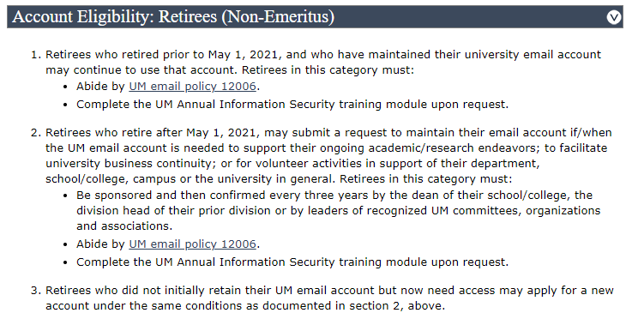
IT Policy

Slide 53
Email to Emeritus Faculty
“Good day,
This note is going out to all emeriti to explain a recent procedural change by the UM System that affects emeriti access to resources. The purpose of the changes is to ensure that we have active HR records before allowing access to certain resources, such as Shibboleth authentication and access to library journals. To resolve this change to resource access, you will need to request a courtesy appointment with HR through your former department. It is fine if you just forward this email to your department as a way of explaining the issue as the change was not well communicated before going into effect.
As for your account/email access, I have placed a 3 year exception on your account so nothing will happen there. That is unaffected by the change above. There will be some upcoming account automation for notification and auto extensions of your account exceptions. As it isn’t written yet, I’m manually tracking and ensuring access continues for your email.”

Slide 54
Summary
Emeritus faculty retain access to email, campus wi-fi login, access to digital library resources indefinitely
Retired faculty may retain access to email, campus wi-fi login, access to digital library resources by requesting a courtesy appointment from their department
IT is in the process of automating the process

Slide 55
Agenda
VI. Reports of Standing Committees
E. Library and Learning Resources J. Porcel

Slide 56
Library and Learning Resources
State of the Library Report 2022 - 2023

Slide 57
Acquisitions - System
Shared System Services
$2,737,240 budget allocation will remain flat or decrease
Existing system allocation will be redirected toward:
Infrastructure support
FOLIO, shared cataloging (open source, paying EBSCO to host and manage)
EDS, shared discovery tool (EBSCO)
Support personnel

Slide 58
Acquisitions - System
Shared eResources Lost at the System Level
 | Lost at the System Level | Retained with local funds
1 | Art Full Text | ACM Digital Library
2 | Business Source Premier | Education Full Text
3 | Cell Press Collection | IEEE Xplore
4 | CINAHL | JSTOR Arts & Sciences I
5 | Communications and Mass Media | JSTOR Arts & Sciences II
6 | Education Index Retrospective | JSTOR Arts & Sciences III
7 | JAMA | JSTOR Arts & Sciences IV
8 | JSTOR Health & General Sciences | MathSciNet
9 | LWW High Impact Journals | MLA International Bibliography
10 | Mergent Archive Fee | PsycARTICLES
11 | New England Journal of Medicine | Science
12 | Ovid Nursing Collection (5 titles)
13 | Philosopher's Index
14 | Project Muse
15 | ProQuest Technology Collection

Slide 59
Acquisitions - System
Remaining Shared Electronic Resources
Remaining eResources at the System Level
Academic Search Premier | 83,138.00
Nature¹ | 29,254
Nature Research & Reviews² | 192,144
PsycInfo | 99,632
SciFinder Scholar | 366,038
Scopus | 283,095
 | 1,053,301

Slide 60
Acquisitions - System
Electronic Resources Retained from System Loss
ABI/Inform Complete | 16,838
ACM Digital Library | 2,927
Education Full Text | 2,697
IEEE Xplore | 42,297
JSTOR Arts & Sciences I | 2,077
JSTOR Arts & Sciences II | 2,106
JSTOR Arts & Sciences III | 2,691
JSTOR Arts & Sciences IV | 3,735
MathSciNet | 9,734
MLA International Bibliography | 6,562
PsycARTICLES | 11,214
Science | 8,337
Subtotal | 111,214

Slide 61
Acquisitions - System
Revisioning of Shared System Services
In FY24 we may lose some or all the projected budget surplus
There is conversation of hiring additional support staff
One position is open but vacant
An additional position may be created
Funding for new positions and future merit or wage increases will not be provided by UM System
UM System Budget to remain flat

Slide 62
Acquisitions
Recommendations
Hold on making cuts to local acquisitions, for now.
If the trend continues investigate the possibility of retaining/acquiring additional resources
Seek budget increase for next fiscal year
Work with colleges to determine future strategic resource needs
Explore additional funding opportunities
Explore expanding open access sources

Slide 63
Operations - Library
Operations Budget – Personnel
Over the past 6 years we have seen a 65% reduction in staff
The following positions are open but unfilled:
Dean
Research Librarian
LS1 (Technical Services)
LS2 (Technical Services)
We are actively searching for:
Research Librarian
LS2 (Technical Services)

Slide 64
Operations - Library
Operations Budget – Hourly Staff
Revisioning Duties and Classification
We have completed a review of job descriptions
Because of reductions some staff are performing duties beyond their classification
We need to consider reclassification of some staff positions
Reductions have resulted in
Heavy reliance on student employees
Scheduling challenges
Labor allocation issues

Slide 65
Operations - Library
Recommendations
Seek budget increase for next fiscal year to cover staffing needs
Reclassify staff positions
Reclassify Librarians to NTT
Seek additional funding options

Slide 66
Agenda
VI. Reports of Standing Committees
F. Budgetary Affairs M. Fitch

Slide 67
Budgetary Affairs Committee
Nov 12, 2022
Continuing referrals:
Report on the “big picture balance sheet”
Current and next FY budget
Referrals:
Discount Rate

Slide 68
Budget
Current FY budget
Financial aid (discount) better than expected, not all of $1 million contingency gone, but concern over grad student loss at end of CY
Next year (FY 2024)
State appropriation
5% increase, maybe
Tuition:
Enrollment might rise: +40% y-t-y applications but lowered yield expected
Tuition model change to tiers, designed as net zero change
But inflation may drive tuition increase

Slide 69
General Revenue Budget
 | FY20 | FY 21 | FY 22 | FY 23 (budgeted)
Tuition and Fees | $126,853,439 | $119,477,148 | $119,255,572 | $123,885,664
Scholarship Allowance | (37,842,663) | (36,728,607) | (38,692,747) | (41,287,426)
Discount | 30% | 31% | 32% | 33%
Net Tuition & Fees | $89,010,776 | $83,748,541 | 80,562,825 | 82,598,238
State Appropriation | 43,543,499 | 45,690,941 | 53,026,096 | 55,942,347
Gift Revenues | 385,737 | 493,109 | 441,381 | 347,500
Recovery of F & A | 6,802,499 | 6,496,349 | 7,611,796 | 7,290,000
Endowment & Investment Income | 1,992,727 | 1,891,705 | 3,399,798 | 3,391,902
Sales & Services Income | 1,177,479 | 709,380 | 1,125,303 | 999,930
Other Incomes | 2,872,553 | 2,209,518 | 2,841,403 | 2,067,024
Revenue Contingency | - |  | - | -
Total Revenues | $145,785,270 | $140,239,544 | $149,008,602 | $152,636,941
Enrollment: -241 UG, +108 grad
Blank = covers $1 MM tuition shortfall

Slide 70
General Revenue Budget: costs
Total Revenues | $145,785,270 | $140,239,544 | $149,008,602 | $152,636,941
+$3.63 million
Transfers | FY20 | FY 21 | FY 22 (actual*) | FY 23 (budgeted)
Internal | $4,442,960 | $1,988,391 | ($1,097,298) | $1,470,667
Mandatory Transfers | (3,930,896) | (3,483,219) | (3,285,882) | (3,376,171)
NonMandatory Transfers | (6,885,979) | (7,114,077) | (4,445,964) | (3,850,000)
Total Transfers | ($6,373,915) | ($8,630,105) | ($8,829,144) | ($5,755,504)
Expenditures
Salaries & Wages | $80,232,396 | $75,195,068 | $72,970,747 | $80,441,613
Benefit Expense | 25,029,887 | 24,209,899 | 23,542,539 | 27,358,459
Compensation | $105,262,283 | $99,404,966 | $96,513,286 | $107,800,0030
Other Expenses | 33,203,896 | 32,471,617 | 35,350,345 | 39,0449,616
Total Expenditures | $138,466,179 | $131,876,584 | $131,863,631 | $146,849,689
 |  |  | Increase | $14,986,058
Open:
31 Faculty
90+ Staff
Was 1.247 M increase:
Maintenance +485k
Utilities +437k
IT (from IT fee) + 26.5k
Insurance, etc. +250k
Summer session + 48k
Enroll. contingency +200k

Slide 71
Discount rate (data for FY 2023, from System)
FY 2023
1 July 2022 – 30 June 2023
Tuition and fees revenue: $124,421,000
Full pay amount, no financial aid
Equals official tuition rate × students
Discount $69,713,000
Amount not paid by students
Sources
Pell Grants $6,300,000
Government scholarships $5,000,000
‘Restricted Non-Gift Aid/Waivers’ (= charged to grants) $4,754,000
Donated scholarships (‘Restricted Donor Aid’) $12,354,000
‘Unrestricted’ $41,305,000
Amount paid by students $54,708,000

Slide 72
Discount ($ Millions)
Revenue source
Revenue
Actual Revenue
Pell
$124.4
Gov’t scholarship
Restricted non-gift
Donated scholar.
$41.3
Markdown
(Scholarship allowance)
$83.1
$54.7
S&T gets
Students pay

Slide 73
Discount Rate
Revenue source
Revenue
Actual Revenue
Pell
$124.4
Gov’t scholarship
Restricted non-gift
33.2%
Donated scholar.
56.0%
$41.3
Markdown
$83.1
$54.7
S&T gets
Students pay

Slide 74
Laffer Curve Discount
Net Tuition Revenue
Donated scholarships, full pay/full external scholarship students
$0
0%
100%
Internal Discount

Slide 75
Discount Rates in UM System
F&O says: 59.1
55
55.6

Slide 76
S&T Laffer Curve?

Slide 77
Net Tuition Per Undergraduate
$26,480 = General Revenue/FTE students
$13,100 = Arguable incremental cost
$14 = Arguable lowest incremental cost

Slide 78
Net Tuition Per Graduate

Slide 79
Net Tuition - Distance
 |  | FY2020 | FY2021 | FY2022 | FY2023-Budget
 |  | Fall 19 | Fall 20 | Fall 21 | Fall 22
Graduate
Distance | Tuition Rate | $ 1,200 | 1,200 | 1,200 | 1,200
 | Enrollment | 591 | 592 | 532 | 466
 | Net Tuition | 6,149,637 | 6,411,131 | 5,543,472 | 4,917,000
 | Net per Fall HC | $ 10,405 | 10,830 | 10,420 | 10,552

Slide 80
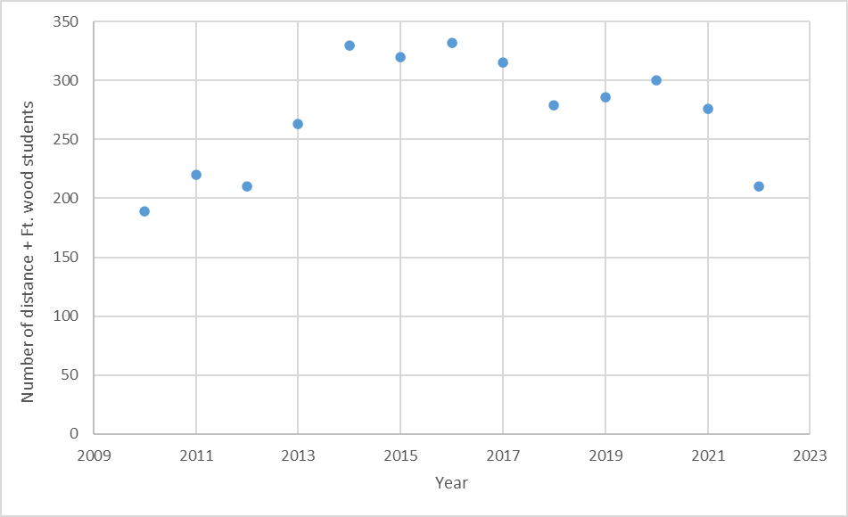
CEC? Distance Enrollment
Dissolve Global,
Cut $ to Departments

Slide 81
Modelling/Hire Consultants
Goal – increase enrollment and net revenue
Look at data from last year
Compare markets
EAB Modeling Tool - determine scholarships/awards based on multi-variables and prior enrollment trends
Weigh increases/decreases in awards against prior year to see results

Slide 82
Agenda
VII. Adjourn
82

